Slide 1



A1 - Needfinding
Presentation

Slide 2


1
Introduction

Slide 3
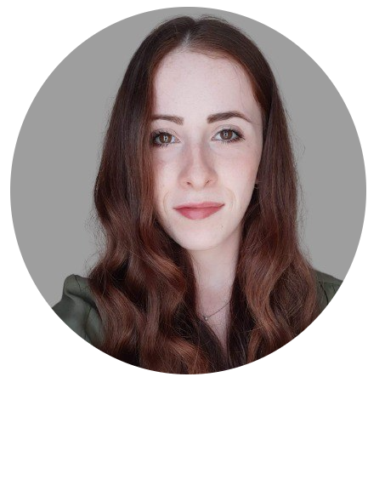
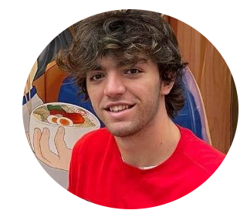

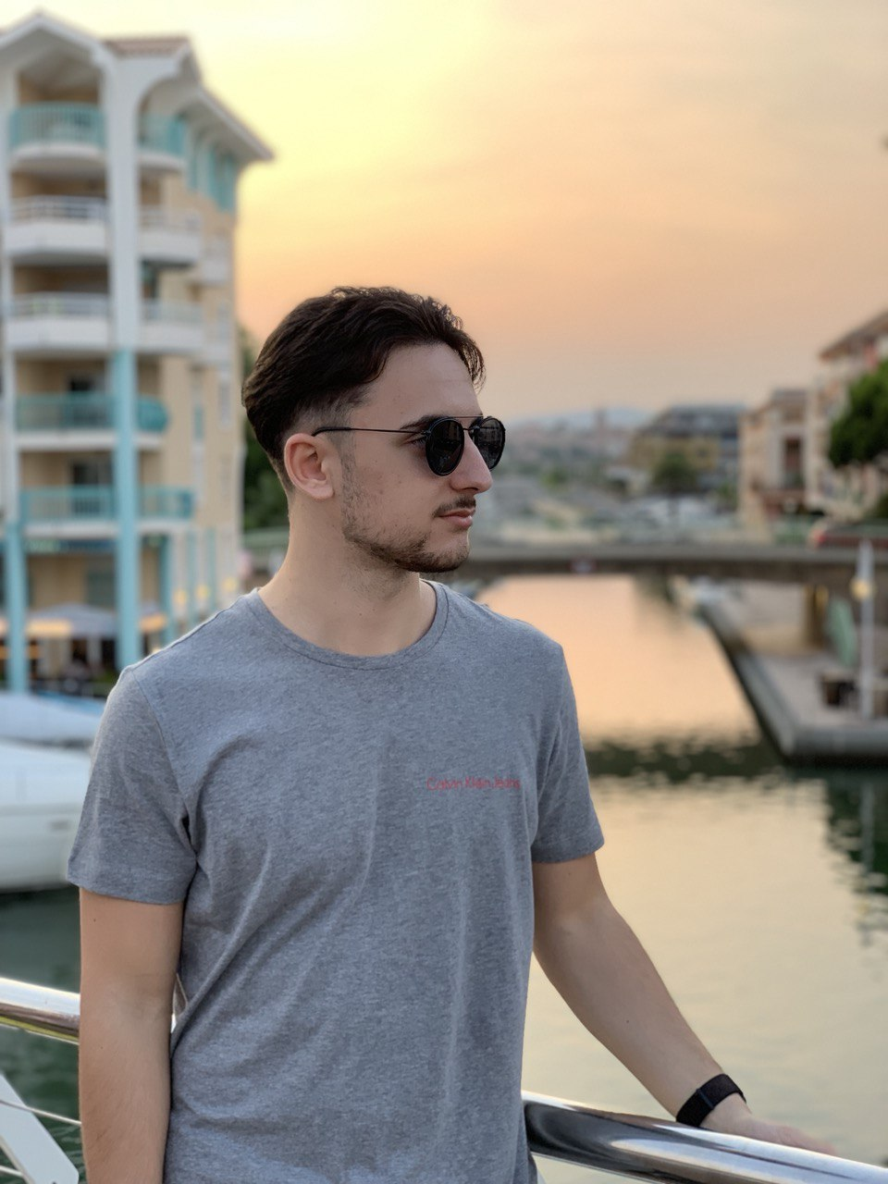
Team members
Sylvie Molinatto
Alessandro Bianco
Elia Ferraro
Kevin Gjeka
I'm a 22 years old Computer Engineering student from Condove, a little town near Turin. I have a deep enthusiasm for computer science and its potential to create a positive and valuable impact on society.
I’m a 23 years old student from Ciriè, near Turin. My two biggest passions are computer engineering and sports. I am currently
studying cybersecurity and I hope to make it my future career.
I’m a 24-year-old student from Asti. I really like software development and music because they are tools to generate emotions from very simple ideas that can improve the lives of people who use them.
I am a 23 years old Cybersecurity Engineering student from Turin. I have a keen interest in cybersecurity and ethical hacking and I hope to contribute to this space in the future.

Slide 4
Domain of interest
As the opportunity for leisure travel has become increasingly accessible, many people choose to explore new cities and experiences on a daily basis. The barriers encountered during a trip planning, while significantly reduced in recent years, continue to be an area of interest, as the use of artificial intelligence could play a significant role in enhancing the experience. For this reason, it is interesting to understand the actual needs of travelers in order to develop applications that can improve the quality of travel planning experiences.

Slide 5
2
Methodology

Slide 6

Interviews details
Interviews were done either via Google Meet or in presence. The respondents signed a form for consent to the processing of the data provided by them. Each interview was conducted by two members of the group, one of whom asked the questions and the other who took notes of the answers. Sometimes there was even a third member to attend the interview.

Slide 7
Questions for the interviews
1
General info (name, age, gender, residence, main cities visited)
2
Tell me 3 positive and 3 negative aspects about trip planning.
3
Describe the best and the worst experience during a city visit.
4
How do you plan your city trip?
5
How do you move during a city trip and why?
6
How do you discover all the attractions to see during the city trip?
7
How do you get tickets for the attractions?

Slide 8
Questions for the interviews
8
Tell me about your meals during the city trip.
9
Do you use tools during your planning? If so, describe them. If no, why?
10
Describe me a failure in a city trip planning and how did you manage to recover from it.
11
What are the most important factors you consider while planning a city trip?
12
What are the most crucial difficulties when planning a city trip?
13
What do you think about real-time information about local attractions or local experiences?
14
How would you improve your city trips?

Slide 9
Questions for the interviews
15
How would you manage money and expenses during city trips?
Additional extreme user questions
1
Tell me about your disability and the challenges related.
2
Do you have any suggestions or recommendations for how trip planning services can better support disabled travelers?
3
How do you get information about accessibility of cultural attractions?

Slide 10
Participants
All the participants we have chosen are young travelers (in the range 20-30 years old) who have experienced the planning of different trips in urban locations. By sharing their experiences, they allowed us to understand what the real needs of tourists are when they find themselves having to arrange a visit to a city. We conducted interviews with four immediate users and one extreme user.
We decided to interview a person with mobility disabilities as an extreme user and we found Desiréè who needs a wheelchair to move. This turned out to be a good choice because it allowed us to better understand some important struggles during the planning phase.
No domain expert has been included in the project.

Slide 11
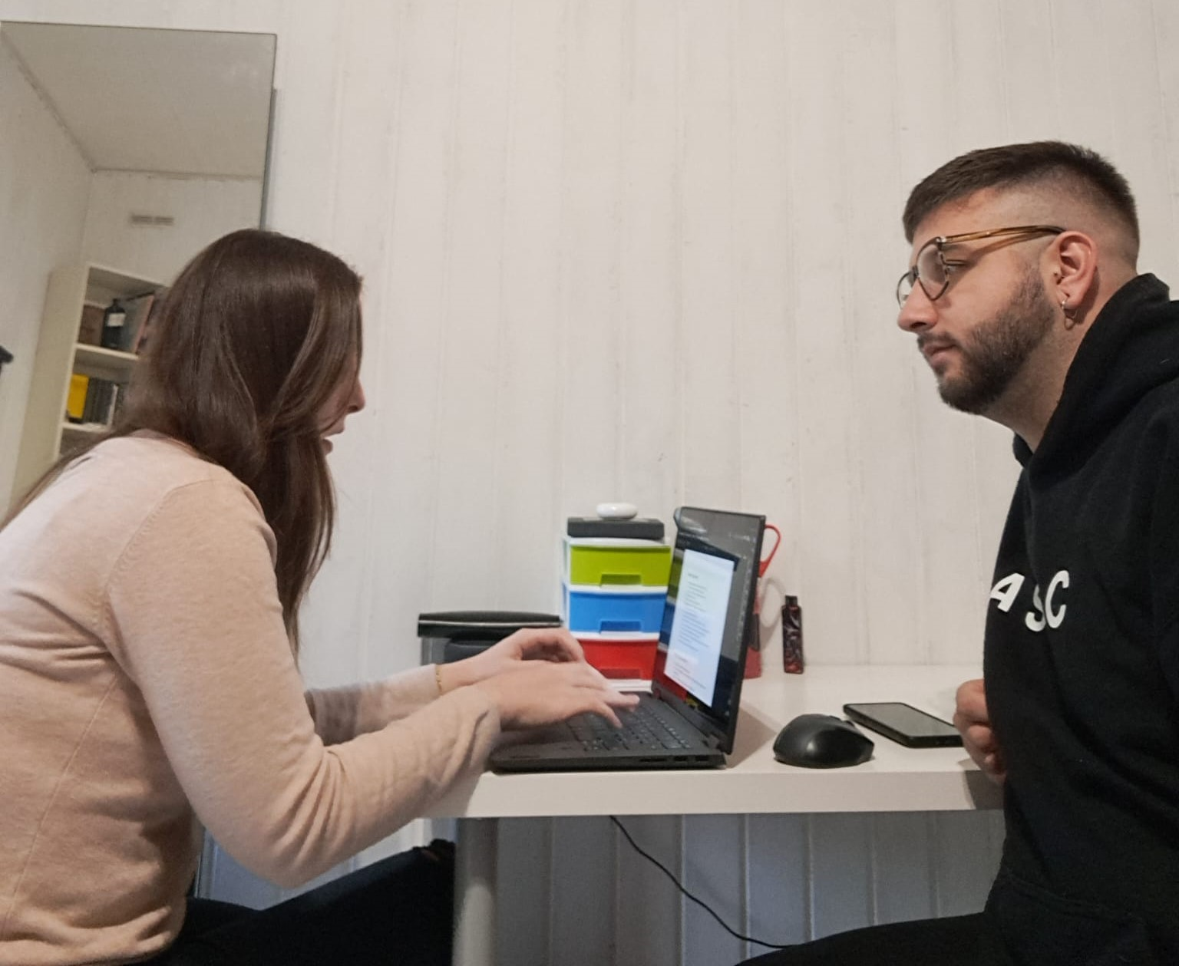
Participants
Sebastiano Callà
Sebastiano Callà is a 23 years old student of Sant'Antonino di Susa, a small town near Turin. He is currently studying at ITS ICT Piemonte to become a Fintech Software Developer. He has a great passion for travel and he has visited many cities including Paris, Madrid, Barcelona, Prague, Krakow and Munich. His willingness to visit these cities leads him to plan all the activities he wants to do and therefore is a great candidate to understand what his needs are when he has to plan a trip to a city
Interviewer: Sylvie Molinatto
Writer: Kevin Gjeka

Slide 12
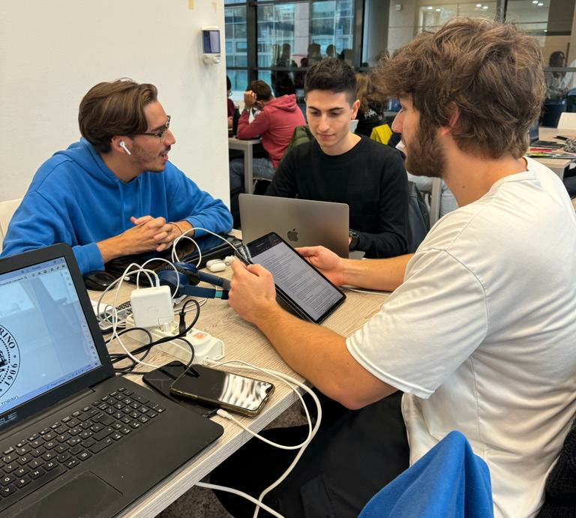
Participants
Riccardo Perrero
Riccardo Perrero is a 25 years old Politecnico of Turin’s student, currently studying Business and Management Engineering.
He has a passion for the blockchain and cryptocurrency.
Riccardo visited the main cities of East Europe and he prefers to visit them in a couple of days each to save money and time, allowing him to study during the week and travel more often.
Interviewer: Alessandro Bianco
Writer: Elia Ferraro

Slide 13
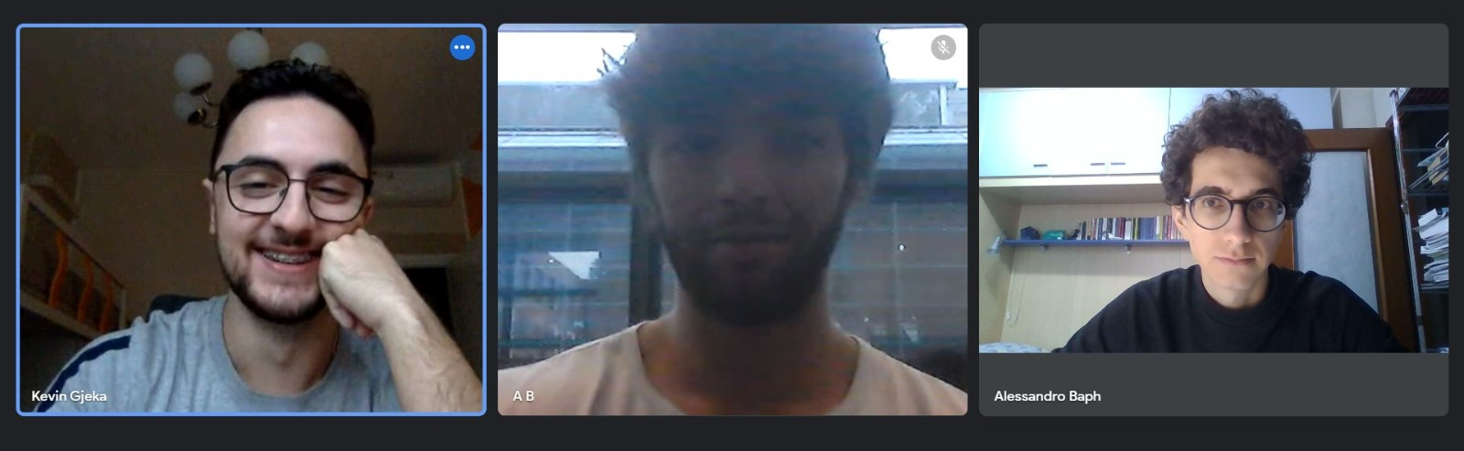
Participants
Alessandro Bafaro
Alessandro is a 24 years old Bocconi’s university student, currently studying politics and policy analysis.
He has a passion for nature, excursions and running.
Alessandro fits the role of an average traveler who has had experiences in Europe’s most popular cities.
He prioritizes eco-friendly means of commuting and can thus give us an insight on what mindful users consider during their city visits.
Interviewer: Kevin Gjeka
Writer: Alessandro Bianco

Slide 14
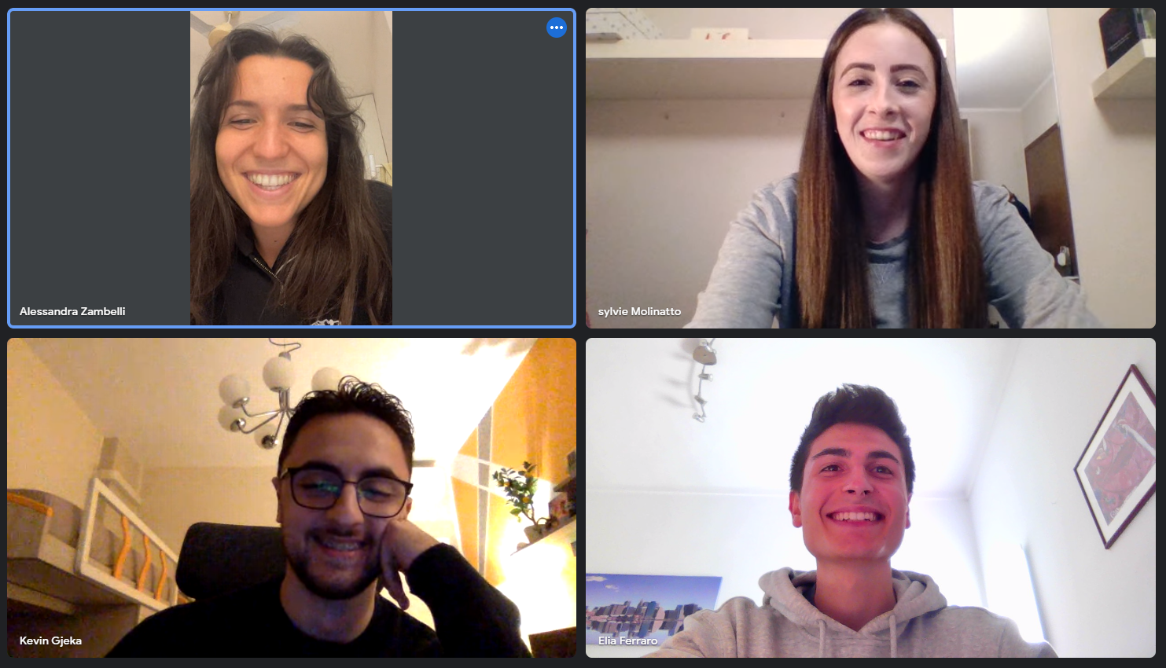
Participants
Alessandra Zambelli
Alessandra is a 23 years old psychologist from Milan, currently working in Rome.
She loves trying new experiences while knowing other people, moreover, she likes travelling to cultural cities but also to naturalistic destinations.
She tends to try typical dishes to fully understand the culture of local people.
Interviewer: Elia Ferraro
Writer: Sylvie Molinatto
Attendant: Kevin Gjeka

Slide 15
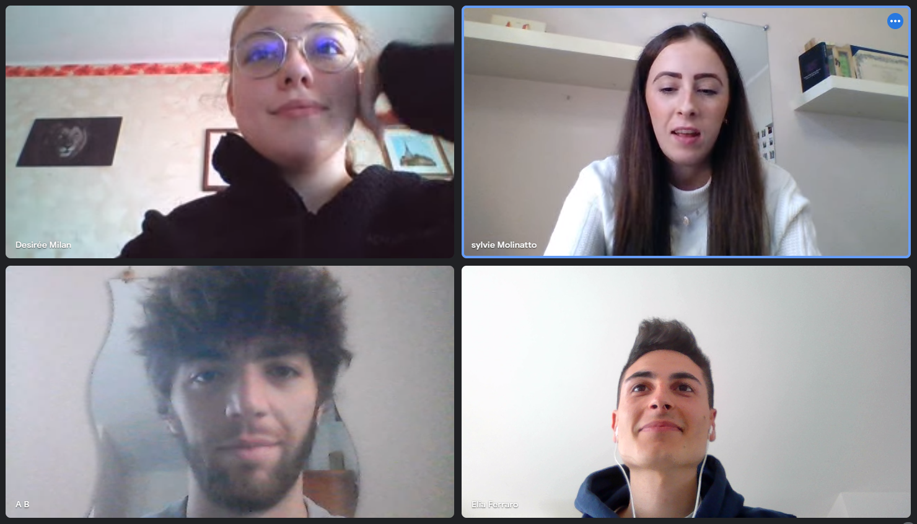
Participants
Desirée Milan
Desirèe is a 20 years old girl from Asti and she is studying communication management in Turin.
She enjoys cultural and fun travels but not relaxing ones.
She has visited many cities for example Venice, London, Amsterdam and Vienna despite the fact that she needs a wheelchair for the most of the trips. She has met a lot of difficulties, but she has managed to overcome them.
Interviewer: Elia Ferraro
Writer: Alessandro Bianco
Attendant: Sylvie Molinatto

Slide 16
3
Results

Slide 17


Key Quotes (Sebastiano Callà)
"One of the positive aspects of organizing a trips is customization, which allows you to tailor the entire trip to your needs, choosing places that interest you the most.”
“Another positive aspect is the cost control, the ability to manage the entire trip cost in detail.”
“Unexpected events are the worst aspect, in my opinion, as even a single unexpected event can disrupt the entire trip.”
“Time constraints can also be a negative aspect because it never seems like there's enough time. “
“Usually, before visiting a city, I look at various maps, check websites of museums and other attractions, and create a list where I list all the attractions I want to visit.”

Slide 18
Key Quotes (Riccardo Perrero)
“I look for all the attractions that I want to visit in the map and I plan to visit everything so that I waste as less time as possible” “At first I look for some special event in the city, then if I’ve already visited that city I try to visit some attraction that I have never seen before ”
“
I set a full holiday budget and also a day by day budget, so that I can try to limit the expences”
“Real-time informations, if accurate, could be very useful to plan the trip and organize myself”
“I found one of the museum that I planned to visit closed, unfortunately I haven't checked anything online before going in place because of my laziness”

Slide 19
Key Quotes (Alessandro Bafaro)
“Planning a trip can be a long and tedious activity when you are done with the list of stuff to do and moved on to booking transports and visits in advance.”
“I browse the internet to compile a list of attractions and then order them by priority, based on the price, commuting time, and the interest I have in each of them, considering time and budget constraints.”
“A friend of mine booked the hotel for the wrong week. Found out the day before. Managed to book the correct week and get a reimbursement for the wrong reservation.”
“I walk, use bike-sharing, or rely on public transportation because it is more cost-effective than alternatives such as taxis or renting a car. Additionally, these methods are eco-friendly, require less planning, and are often faster ways of getting around.“

Slide 20
Key Quotes (Alessandra Zambelli)
“I was looking for a hostel with adequate reviews. I found one with good photos and I booked it. When I arrived I found cockroaches and dirt everywhere. The information I had was terribly wrong”
“Google always propose the same attractions for a specific city. I want to visit alse unusual attractions beyond the most famous ones”
“I would use more specialized apps and websites to plan my trips but they are too complex and time consuming so I only use social network to find new attractions”
“I look for museums tickets online but I always buy them directly at the counter because usually there are discount not available in websites”

Slide 21
Key Quotes (Desirèe Milan)
“I was visiting Venice and I wanted to reach San Marco Square by boat but there was a ferry disruption so I had to replan my trip and to struggle in narrow streets and on difficult stairs.”
“I always check deeply the accessibility of all structures I want to visit. I use forum or special websites to do that. Sometimes, when I am in the building I notice that many obstacles are not signaled before in the websites. This happens even if I directly call the structure personnel for clarifications.”
“I cannot change plans at the last minute because I need time to organize my trips from a place to another. I have to look for a transportation mean that can carry the wheelchair.”
“I would like to book museums tickets online but the websites never give the possibility to buy a reduced ticket for disabled persons. For this reason I run the risk of not being able to enter.”

Slide 22
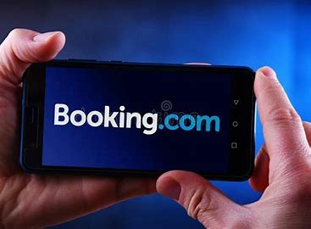
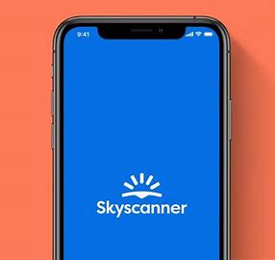

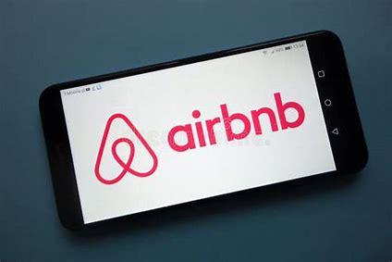
Artifacts

Slide 23

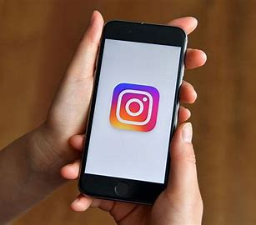
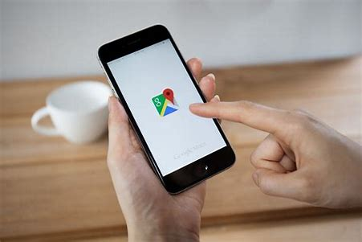

Artifacts

Slide 24
4
User Needs

Slide 25
Brainstorming
SYLVIE
The user needs to tailor the entire trip to his interests
The user needs to manage the entire trip cost in detail
The user needs to waste as little time as possible
The user needs to be able to adjust a trip schedule in case of failure
The user needs to reschedule the trip plan in case of failure
ELIA
The user needs to be able to know real information before the trip
The user needs to be able to organize the trip in a faster and simple way
The user needs to be able to discover unusual attractions, which are not the most visited and known ones
The user needs to be able to reach his destination even though there are misleading information during the planning phase
The user needs to be able to know precise and detailed information about interior attraction accessibility
The user needs to be assisted by more qualified personnel
ALESSANDRO
The user needs to keep his expenses under his trip budget
The user needs to get reliable and complete informations from his source/sources
The user need updated live information about attraction The user needs to optimize the organization not to waste too much time while moving between places
The user needs to know if booking is mandatory or not for his desired attraction
The user needs to have fast access to information
The user needs to know an expected queue for each attraction
KEVIN
The user needs to find a balance between more cheap fast foods and expensive proper meals
The user seeks an efficient trip planning
The user needs to manage the budget
The user needs to feel safe (example reimbursement) in case of a failed reservation

Slide 26
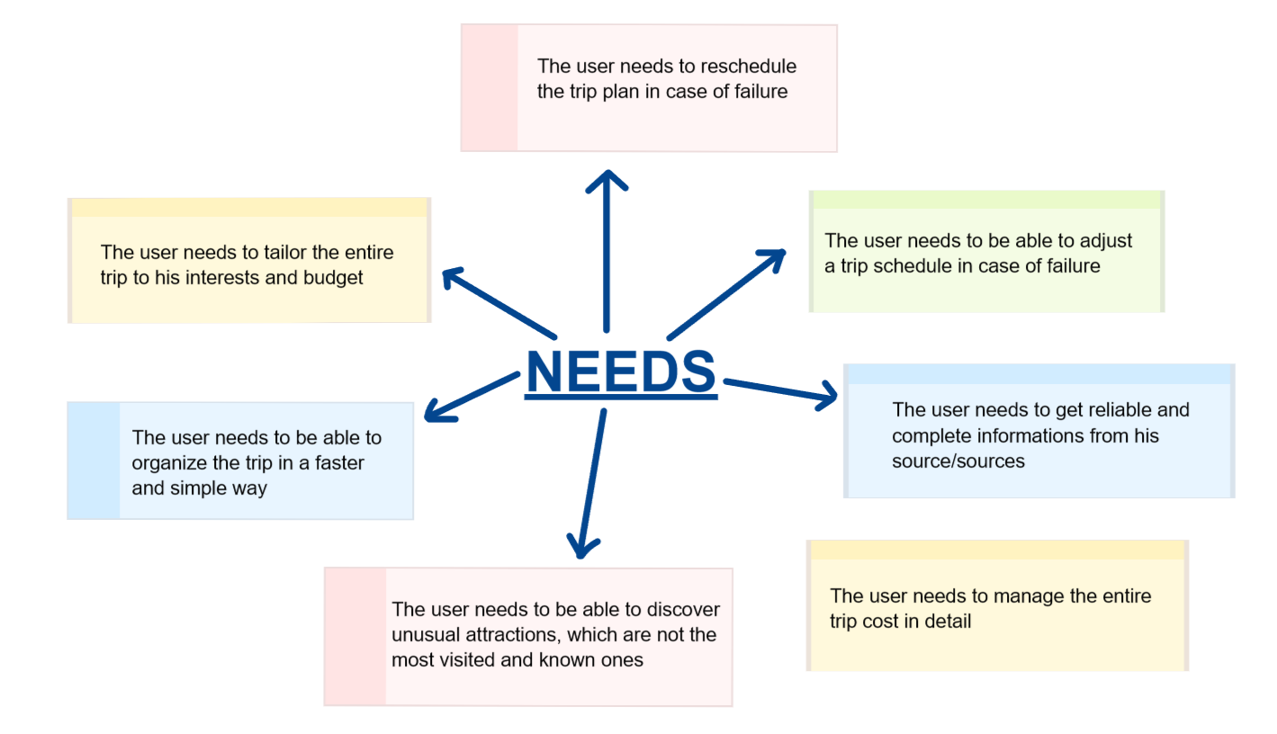
Brainstorming

Slide 27




Deep User Needs
Personalize
The user needs to tailor the entire trip to his interests and expenses budget
Reschedule
Reliable
The user needs to reschedule the trip plan in case of failure
The user needs to get reliable and complete information from his source/sources
Fast
The user needs to be able to organize the trip in a faster and simple way

Slide 28
Deep User Needs
“By planning my trips, I can choose and filter only the attractions I prefer.” (Alessandra)
“Planning a trip can be a long and tedious activity when you are done with the list of stuff to do and moved on to booking transports and visits in advance.”
(Alessandro)
"Planning a trip is a cost-free activity that is enjoyable and encourages creativity in designing a customized trip that suits your needs." (Sebastiano)
Personalize
Fast
“I was visiting Venice and I wanted to reach San Marco Square by boat but there was a ferry disruption so I had to replan my trip and to struggle in narrow streets and on difficult stairs..”
(Desire)
"Real-time information is extremely useful as it keeps you updated on local events, sudden openings and closures. This allows for better adjustment of your itinerary to make the most of your trip.“
(Sebastiano)
Reschedule
Reliable
“Often, looking on internet, different websites tell different things.”
(Riccardo)

Slide 29
5
Solutions

Slide 30
Solutions
Survey to understand user preferences and create the itinerary accordingly
Personalize
Meetings with people who share similar interests in order to share their travel experiences
The user can purchase a smartbox with various experiences to choose from
Fast

Slide 31
Solutions
A customer support service that can be contacted at any time
Allowing local volunteers to help users in need
Reschedule
Camera system to provide real-time information on attraction queues or the overall status

Slide 32
Solutions
3D tour of public places and attractions
Allow the user to get in touch with people who have already had the same experience for any questions
Reliable
Camera system to provide real-time information on attraction queues or the overall status
Site inspections carried out by authorized and reliable individuals regarding the state of the activities offered to the user

Slide 33
Final solution
The proposed solution involves using surveys to obtain information about the user's preferences and limitations, enabling the customization of the suggested itinerary. Additionally, a customer support service, available at any time of need, will be provided to address encountered issues. Periodic inspections of the attractions offered by the service will also be conducted to ensure their conditions.

Slide 34
Project name
and value
proposition
6

Slide 35

We decided to call our project «UrbanHub» because this name emphasizes the urban aspect of the project, making it clear that it's centered around city and urban travel, and suggests a central place or location for gathering information and resources. In the context of trip planning, it indicates that the project serves as a central hub for urban travelers to access everything they need. Indeed, the term "urban" relates to cities and the associated infrastructure, services, and living environments. "Hub" typically implies a central point or a place where various activities, services, or resources converge.

Slide 36

UrbHub
Inclusive and effortless Urban Travel

